Slide 1
TODO list
Externalize strings

Slide 2
DEX Architecture (OTM-DE on JavaFX)
Dave Hollander

Slide 3
Overview
This document is intended to give a high-level overview of how DEX works.
The code and its related JUNIT tests attempt to document how they work.
Acronyms
OTM = OpenTravel Model is a standard for defining information objects
OTM Compiler / TL Model = the compiler that creates XML, JSON and SWAGGER and It also manages access to the repositories
Façade principles in DEX
Let the compiler do what it good at: managing objects (TL Model), validation, file IO
Let JavaFX do what it is good at: events, layouts, editing, tree-table displays

Slide 4
DEX Application Architecture
model
OtmObject
Dex.actions
Object Editor App
Object Editor Controller
Action <T>
OTM Model Element
Action Manager
Main()
Tab Controller
doIt()
getSubject()
isAllowed()
isEnabled()
isValid()
undo()
Model Manager
isEnabled()
Do()
Undo()
-- manage queue
Dex.controllers
Dex Controller
Maps
Projects
Version Chains
Libraries (TL <-> OTM)
Members (TL <-> OTM)
Dex DAO <T>
Included Controller <T>
getValue()
getIcon()
Configure()
Clear(), Post(), Refresh()
Publish Event()
Row Factory <T>
Dex.tasks
Task
Task Result Handler (I)
Dex.events
View Controller <T>
FX Event Dispatcher
FX Event
@FXML initialize()
Task Base<T>
Handle Task Complete()
DexEvent Dispatcher
DexEvent
@FXML
Handle events
doIT()
background thread

Slide 5
DEX Application Architecture
Dex.actions
Action Manager
Action <T>
Actions
user initiated, model changing behavior
Controllers
Interaction with FX widgets
Events
All inter-module communication
Model
Facades for the OTM “TL” model
Tasks
Background processes
Dex.events
model
FX Event Dispatcher
FX Event
OtmObject (I)
Otm Model Element
Dex Event Dispatcher
DexEvent
Model Manager
Dex.controllers
Dex Controller
DexDAO <T>
Dex.tasks
Included Controller <T>
Task Result Handler (I)
Task
RowFactory <T>
Task Base <T>
* View Controller

Slide 6
Actions
Dex.actions
Action (I) <T>
*Action
Actions orchestrate model changes
There are a lot of actions (~70).
General (create, delete, rename, etc.), resource-oriented, constraint-oriented, etc.
Actions
Have a subject
Are enabled, do-able, undo-able, veto-able
Maintain whatever information is needed for undo
Action Managers
Instantiate specific actions
Control what is enabled
Orchestrate instantiation, run, events
Maintain action queue to be used to undo
doIt()
getSubject()
isAllowed()
isEnabled()
isValid()
undo()
Action Manager
Action Manager Base
Read Only
Minor Version
Full

Slide 7
Actions Design
View Controller
Action Manager
Action
Actions (Factory)
Actions orchestrate model changes
Enabled(), Do(), Undo()
Initiated by user via controller
Perform business logic via model
Publish events when complete via controller
3 classes of actions
Run – controller explicitly run()s the action
String, Boolean – FX runs the action
action manager returns FX Property with listener set to specific action instance
Each action instance must remember how to undo the action.
Controllers do not have logic to know if actions is enabled or applicable. They:
Ask the object for its controlling action manager
Objects use library status to determine which type of action manager to return
Never construct a new action
Ask object for its manger.
Ask manager if action is enabled.
Or Use Static isEnabled() in each action class
Use ActionManager’s add() or run()
Action Manager and Factory checks to see if the action is enabled and suitable for the subject object
Action Managers
Uses factory’s getAction() to create specific instances of actions.
Uses factory’s getEvent(DexAction) to create events specific to the action.
DexActions is Action Factory
Enumerates actions and events
Method for instantiating specific actions

Slide 8
Action Manager Run Action Usage
Dex.actions
Action Manager
Dex.controllers
Action (I) <T>
View Controller
Row Factories
@FXML
Menus
Buttons
isEnabled()
Do()
Undo()
-- manage queue
*Action
doIt()
getSubject()
isAllowed()
isEnabled()
isValid()
undo()
Specific action enabled and run
Enabled
Run
Undo
deleteItem.setDisable( !am.isEnabled(DexActions.DELETEPROPERTY, property ) );
Action Manger selected based on Library and Object
// Controller Row Factory: Runs if menu item on a row is selected
private void changeAssignedType(OtmTypeUser user) {
user.getActionManager().run( DexActions.TYPECHANGE, user, null );
}
model
OtmObject
Library Members
Get ActionMgr()
Model Manager
Read Only
Minor Version
Full
modelMgr.getActionManager( true ).undo();
Never construct a new action

Slide 9
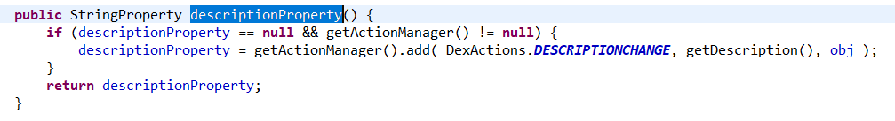
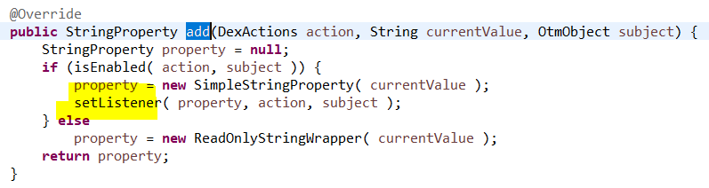
Action Manager String Action Usage
String actions use FX String Properties to allow FX widgets to handle all editing.
Model object’s *Property() methods get a FX String property from the action manager.
org.opentravel.model.OtmDocHandler
If enabled() Action Manager sets a listener on the FX String Property with the new action to be performed if the string is changed.
Otherwise, a read only property is returned.
org.opentravel.dex.action.manager.DexActionManagerBase

Slide 10
Controllers
Dex Controller
Main
Included <T>
Pop-up
Controllers interact directly with JavaFX widgets
Table and Tree Table controllers have:
Controllers are reusable
Designed to have the exact same code used wherever needed.
Events – Subscribers and Publishers (implement OtmEventUser)
Controllers subscribe to model change and navigation events
RowFactories – describe view and formatting of each row including menus and actions
DAO (Data Access Objects) – maps Model Objects to row field values
Ex. MemberTreeTableController used in primary view and in type selection
Controllers can publish events for other controllers to respond to
DexMainControllerBase handles publishing and subscriptions registration of individual controller with FX event structures.

Slide 11
Application Controller
Application
FX Application
FX Loader Creates Controller
Abstract OTM Application
Abstract Main Window Controller
Object Editor App (a.k.a. Dex)
Extends Abstract OTM Application
Which extends FX Application
When started, JavaFX
Constructs Object Editor Controller
Calls main() and start()
App#start() sets the stage in the controller which:
creates singletons for model and events
configures other controllers
Abstract Main Window Controller
Repository Manager
Stage
User Settings
Dex Main Controller Base
Object Editor Controller
Object Editor App
Set Stage()
Model Manager
Event Subscription Manager
Menu Bar
Tab Controllers
Status Controller
Filter Controller
Member Tree-Table Controller
Main()
Start()
Note: reuse patterns allowed for the standalone repository application that has not been tested for years.

Slide 12
Controllers Design
Main
Access to singletons (model manager, FX stage, repository)
Access to Menu bar, Member, Status and Progress controllers
Tab Controller
One per FX Tab
Instantiate included controllers
Launch() as standalone window
Included Controllers
One per FX pane
Pop-up
Modal dialogs
Stand-alone windows
Interface Hierarchy
Dex Controller
Dex Tab Controller
Main
Included <T>
Pop-up
Creation – flow of control
Object Editor App
Object Editor Controller
Tab Controller(*)
Main()
setStage()
configure()
Included Controller(*)

Slide 13
Included Controllers
Dex.controllers
Dex Controller
One per FX Pane
Generic interface type parameter is the business data that it can post()
Controls all widgets on that pane
Invokes Actions or Tasks
Display business data in its widgets
Post(T)
Clear()
Refresh()
Events
Registers published and subscribed events
Fire event using its eventPublisherNode
Handles received events
DexDAO <T>
Included Controller <T>
getValue()
getIcon()
Configure()
Clear(), Post(), Refresh()
Publish Event()
*view Controller
*view Controller
…
@FXML
Handle events
@FXML
Handle events

Slide 14
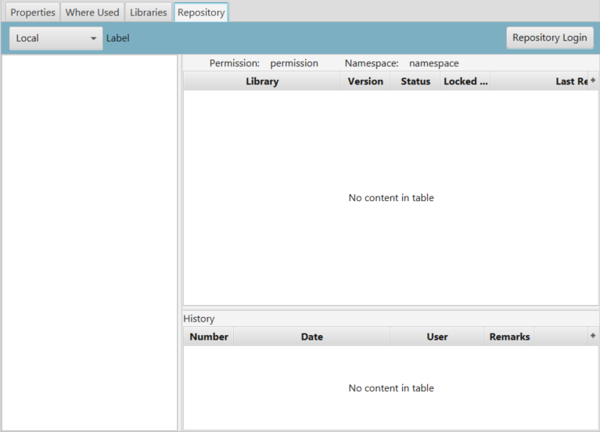
Repository View Controllers
repository
Repository Tab or Window Controller
Repository Selection Controller
Repository Login Dialog Controller
Configure(DexMainController)
Post(RepositoryManager)
Tab and Window controllers are nearly identical.
Window controller uses a modal, pop-up stage
Differences isolated in Tab and Window Base classes
Repository Tab Controller supports 5 included controllers
Tab controllers configure their included controllers
Once configured, each controller acts independently
Events signal change to selections
Repository Namespaces Tree Controller
Configure(DexMainController)
Post(Repository)
Namespace Libraries Tree Table Controller
Repository Item Commit Histories Controller
Configure(DexMainController)
Post(NamespacesDAO)
Post(RepoItemDAO)
NamespacesDAO
RepoItemDAO
RepoItemCommitDAO

Slide 15
Controllers Tree Tables
FX TreeTable used in many controllers
FX provides column headers, sorting, collapse controls, etc.
Tree Table Controllers
Initialize the table and buildColumns()
Assign a RowFactory to the table
Row Factory
Creates item menus
Initiates actions or tasks
Controls how contents are formatted (bold, italic, etc) using CSS
Post()
Create DAOs (data access objects) for each row
Create TreeItems from the DAO and add to table’s root or other TreeItems

Slide 16
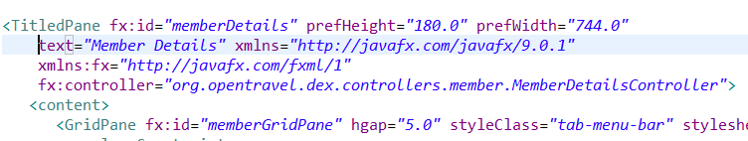
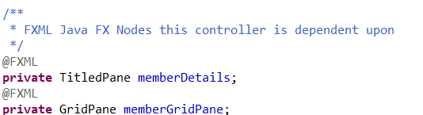
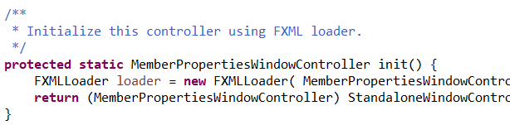
Controllers FX Usage
/otm-dex/src/main/resources/MemberViews/MemberDetails.fxml
FXML File
Defines FX Nodes (Panes) and their contents
1 Java Controller per FXML File
Set-up
FX Initialization -Top level windows only
Configure() - Set-up from a parent
CheckNodes()
Debugging aid to assure all FX widgets are injected by loader before use
NOTE: FX is “fussy” about names of the widgets and the associated Java objects.
/otm-dex/src/main/java/org/opentravel/dex/ controllers/member/MemberDetailsController.java

Slide 17
Cookbook: Building a Pop-up Controller
Clone an example controller from package org.opentravel.dex.controllers.popup;
Clone same example fxml file
Modify in Scene Builder
Change controller java class
Update controller fxml fields
Comment out/delete old business logic – just leave setup
Add init() and showAndWait() calls:
UnlockLibraryDialogContoller uldc = UnlockLibraryDialogContoller.init();
uldc.showAndWait( "" );
String remarks = uldc.getCommitRemarks();
Test
Create dialog JUNIT
Develop business logic and junit together

Slide 18
Events
Dex.events
FX Event Dispatcher
FX Event
DexEvent Dispatcher
DexEvent
Provide
Abstraction for activities that change the model.
Dex Event
Layered on top of FX event architecture
Abstraction for activities that influence what should be displayed.
Isolation between controllers and other modules.
Dex Event Dispatcher
FX events of type Dex Event are intercepted by Dex Event Dispatcher
FX Node in Controllers publishes and subscribes to Event
Changes to the model are subscribed to by the controller
Model manager is notified of Change events
Navigation events are added to the event queue

Slide 19
Architecture Events
Main Controller
Window Controller
Tab Controller
getEventSubscriptionManager()
How to abstract which producers there are, and which events consumers want?
Each OtmEventUser has getters for published and subscribed events
register() controllers with the OTM Event Subscription Manager
When configured() the subscription manager uses setHandler() on each producer to set the consumer’s handlers for each event type
Result
Most event registration code abstracted into base classes
Configuration at startup –OR- when forced by a controller
Runtime events dispatched using FX framework
Event chains can span windows and applications that share access to the subscription manager
OTM Event Subscription Manager
Event Producer Controller (OtmEventUser)
setHandler()
Published map
Subscribed map
Register()
Configure()
Event Consumer Controller
(OtmEventUser)
eventHandler()

Slide 20
Event Architecture Set-up
Abstract Main Controller
Abstract Included Controller
addIncludedController()
-- add to event publishers map
-- add to event subscribers map
configureEventHandlers()
-- set handlers into publishers
Constructor(EventTypes[])
getPublishedEventTypes()
getSubscribedEventTypes()
setEventHandler()
eventHandler()
Included Controllers
Use super-type constructor that supports getting Generated and Subscribed Event Types
Set event handlers for published types
Each Publisher must set FX Node used to fire event
Event handler passes events to methods within controller
Main Controllers
Adding included controllers collects published and subscribed event types
After all controllers are collected, configures publishers with subscribers’ handlers
Concerns
Minimal code in controllers
Assure run only after all controllers are initialized and included into controller lists
No Dex code in runtime path, only in setup and configuration
Loops – event triggering 2nd event triggers event
Main Controller
Event Producer Controller
EventPublisherNode
Tab Controller
Fire
Dex Event
Window Controller
handler()
Event Consumer Controller

Slide 21
Event Architecture Runtime
Event Source
Approach: leverage and extend JavaFX event architecture.
Events provide the ability to loosely couple the interaction between two or more controllers
Dispatcher passes events to Event Handler in consumers
Each JavaFX node is associated with a dispatcher
Menu bar controller intercepts dispatch chain for debugging
node.setHandler()
fx:node
node.fireEvent()
DexEvent
Dispatcher
Event consumer
handler()
Event consumer
handler()

Slide 22
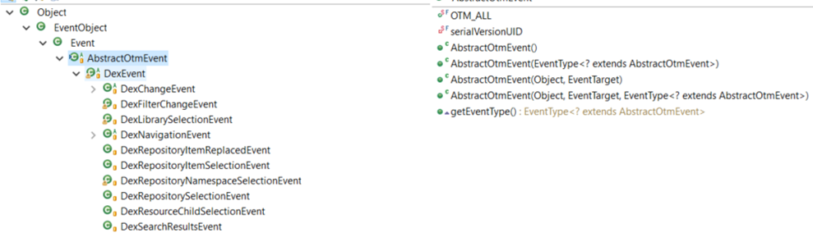
Event Architecture Cookbook
Publisher
Define Published events array
private static final EventType[] publishedEvents = { DexMemberSelectionEvent.MEMBER_SELECTED };
Add published events array to constructor
super(subscribedEvents, publishedEvents);
Set event Publisher Node in configure()
eventPublisherNode = memberTreeController;
Fire event
eventPublisherNode.fireEvent(new DexMemberSelectionEvent(this, item));
Can be fired from handlers that have access to this controller via the super-type.
Consumer
Define subscribed events array
private static final EventType[] subscribedEvents = { DexFilterChangeEvent.FILTER_CHANGED };
Add subscribed events to constructor
super(subscribedEvents, publishedEvents);
Create event handlers
public void handleEvent(Event event) {}
private void handleEvent(DexMemberSelectionEvent event) {}
Create ignoreEvent Boolean if needed to protect from loops

Slide 23
Model
model
OtmObject (I)
OtmModelElement
Model Manager
The Dex Model
Provides façade to the compiler’s TL model
Linked to Compilier’s TL Model
Via a listener on the TL object
Design
Extensive use of stereotypes and stereotyped behavior
All model changes use Dex Model APIs to change the TL Model
Creates and maintains aggregates needed for displays
Via a map in the Otm Model Members Manager
Provides façade for JavaFX widgets and Dex Controllers
Managers for access to objects, libraries, projects and namespaces across the model

Slide 24
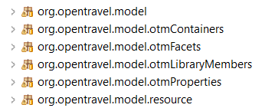
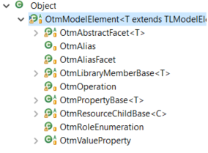
Model Design
Objects
Model objects represent user defined the OTM objects
Containers: libraries, projects
Facets: summary, detail, contributed facets, etc
Library Members: business, core, contextual facets …
Properties: elements, attributes …
Resources
Handlers – owned by objects to simplify common behaviors
Managers – singletons to provide access to the objects

Slide 25
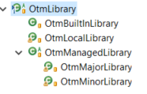
Model Design Containers and Libraries
Project Item
Abstract Library
TL Library
OTM Library
Project – just a collection of libraries.
Libraries contain members.
Member editability is largely controlled by the state/status if its library.
Member action manager type controlled by libraries.
Libraries are units-of-work for file system and repository.
Local – read/write from local file system
Managed – managed in a repository
Libraries have a factory.
Libraries wrap TL AbstractLibrary
Libraries with a ProjectItem are made into a Managed library
Domain – work-in-progress.
Library Factory

Slide 26
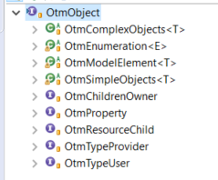
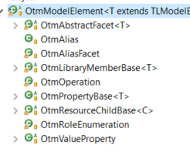
Model Design Class Structure
Interfaces used to define behavior sets
Not used to define class hierarchy
Abstract base classes
Define class structure
Implementation of common, stereotyped behaviors
Model Interfaces
OtmObject (I)
ChildrenOwner
Library Member
Property
Property Owner
Resource Child
Type Provider
Type User
Library Member Base
Otm Model Element
Abstract Facet
Resource Child Base
Note: this evolved significantly and may well be due for refactoring.

Slide 27
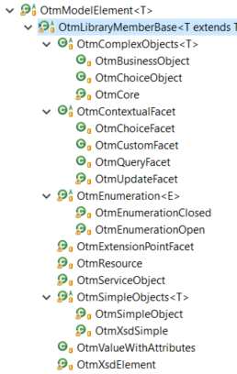
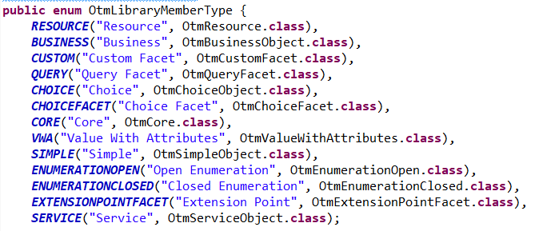
Model Design Library Members
Otm Model Element
Library Member
Library Member Base
Library Members are used as the primary control object.
Objects are edited, moved, deleted, etc.
They contain facets and properties
They are named
Usage managed at the library member level.
Where-used and types-used
The model-manager manages members
Not their facets or properties
They have a factory
Factory wraps a TL LibraryMember with the appropriate generic class façade.
They have an enumerated type class
They implement the OtmLibraryMember interface
TL Library Member
OTM Library Member
Member Factory

Slide 28
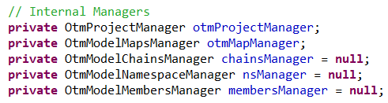
Model Design Managers
If DEX has a heart, it is the OtmModelManager
This singleton is used to track all libraries and members
Model manager maintains maps relating Compiler (TL) and DEX (OTM) objects.
Maps are managed by helper-managers.
Model manager provides facades to access the helpers.
Receives Model Change Events from Event Dispatcher which refreshes the libraries and their members.

Slide 29
Model Design Flow of Control Opening a Project or Library
Task opens library or project using the compiler's model loader. Informs manager when done.
Model manager uses factory to construct OTM Libraries.
Libraries construct members for all named members in TL Library.
Members model their children.
Controllers notified when complete via event dispatcher.
Background tasks created to validate and resolve types.
Controller
Model Change Event
Dispatcher
Background Thread
Type Resolver Task
Go(completion handler)
Background Thread
Validation Task
Task
Background Thread
Dex File Handler
Member Factory
addLibraries()
addProjects()
Library Factory
OTM Library Member
OTM Model Manager
OTM Library
Model children()
Facet Factory

Slide 30

Model Design JavaFX Properties
OTM Objects contain FX properties because benefits overrides MVC concern of adding view semantics to model
This is an FX application
Tables and FX widgets need an observable property
If not added to the OtmObject then each user of that data would have to create a separate property
Requires model objects to refresh() the FX properties when the object changes
The contained FX-observables will help ensure integrity

Slide 31
OTM Object Model Children
Children
childrenOwner.modelChildren() – adds children from the TL object
Lazy evaluation – run when children is null
Inherited children
Children of an inherited facet are copies
Contextual facets are NOT children
Their related contributed facet (whereContributed) are children
Children Hierarchy
List of children organized by inheritance
Used in member properties view
Contents of childrenHierarchy
BO – just ID facet and aliases
Choice – just Shared and aliases
Core – Summary and aliases
ID Facet – inherited, children, summary facet
Shared Facet –
Children and inherited, children
parent’s choice, contributed, and inherited facets
Summary Facet –
Children and inherited children
parent’s detail, contributed and inherited facets

Slide 32
OTM Object Model Inherited Properties
Children are OtmProperties
add children to the parent object
childrenOwner.modelChildren()
Properties need to know if they are inherited without knowing the context.
isEditable() needs to know if inherited
isInherited() not isInheritedBy(owner)
Inherited children
New OtmProperty object
Shared TL Object
isInherited()
return getTL().getOwner() != parent.getTL();
Base Object
Extended Object
TL
TL
Base Facet
Extended Facet
TL
TL
Base Property
Inherited Property
Parent
TL Object
Owner
Parent
TL Object
TL

Slide 33
OTM Object Model Contextual Facets
Contextual facets:
Are library members (extends Library Member).
Are never inherited.
Are never children of objects or facets.
Have children and inherited children.
Are Property Owners.
Contributed facets:
Are facets (extends Facet)
Maintains relationship between contextual facet and object where injected.
Expose a façade for the contextual facet’s children.
Are the only inherited facet
Overrides AbstractFacet.isInherited()
Return getContributor().getWhereContributed() != this;
When Inherited
New contributed facet
Contextual facet has no knowledge of the inheritance
Base Object
Extended Object
Children
TL
TL
Contributed Facet
Contributed Facet
Parent
Contributor
Contextual Facet
Owning Entity
Where Contributed
Children
Inherited Children
TL
Property
Property
Property

Slide 34
Tasks
Dex.tasks
DexTask
DexTaskBase<T>
Task
Tasks
Abstract Task Base extends FXTask to handle task set-up, monitoring, errors and results.
Result Handlers
Via a listener on the TL object
Task Singleton
Interface that extends Dex Task with no behavior
Via a map in the Otm Model Members Manager
Used by DexStatusController to denote tasks that must only have one instance running at a time
Each task need only write its business orchestration in the doIt() method.

Slide 35
Tasks Design
FX Task<String>
Dex Status Controller
Dex Task Base <T>
Task Result Handler
handleTaskComplete()
go()
When a task is created the caller provides
Status controller
Result handler
Optionally, specific tasks may require model manager
If needed, the specific task creates
A progress monitor
File handler
Model Manager
Task
Loader Progress Monitor
Progress Monitor
doIT()
Open Project Progress Monitor
Dex File Handler
On go()
Task creates and starts a background thread
Specific task doIT() logic executed
Exceptions are caught and turned into user messages
On completion
Status is posted and dialog boxes removed
Result handler is notified and passed the event complete with status and error messages

Slide 36
Tasks Task Base Design
FX Task<String>
Dex Task Base <T>
Responsibilities
Thread control
Display “Please Wait” dialog box
Messages
Start-up for status display
Errors and warnings
Go()
Create new Java Thread
Mark thread as Daemon
Start thread
Call()
Called by Java from the background thread
Calls doIT() to begin processing
Catches exceptions
Exceptions populate errorBuilder with user-oriented exception message

Slide 37
Tasks Task Design
FX Task<String>
Dex Task Base <T>
Each sub-type of Task Base is Responsible for
Messages
Start-up for status display
Throw exception on error
doIT()
Task specific behavior written as if in foreground thread
Throwing exceptions on error
Task
Progress Monitor
doIT()

Slide 38
Tasks Dex Status Controller
Dex Status Controller
The Status Controller
Interacts with FX widgets at bottom application window
Status label
Task count
Progress Indicator
Maintains list of running tasks
Posts
Updates FX Progress Indicators
Status label and task count
Called by DexTaskBase on start, cancelled, failed and succeeded
Cancels Singleton tasks if one is already running

Slide 39
Tasks Tracking Progress
LoaderProgressMonitor
Open Project Progress Monitor
Open Project Progress Monitor
Implements compiler’s monitor interface
Receives updates from compiler’s loader
Posts status and progress in status controller

Slide 40
Tasks DexFileHandler
fileChooser() – user selects single File
getProjectList() – list of File from passed directory
openProject() – use ProjectManager to open project File with findings and monitor
Dex.controllers
MenuBarWithProject Controller
Dex File Handler
@FXML
projectComboSelectionListener()
handleOpenMenu()
openFile()
Maps
fileChooser()
getProjectList()
openProject()
openFile()
fileChooser()
openProject()
Dex.tasks
Open Project File Task
Add(ProjectMgr)
Model Manager

Slide 42
Graphics (under controllers)
Sprites – moveable graphic entities
their own canvas
graphics context
Connections
Rectangles
Collapsable (FR)
Clickable (CR)

Slide 43
Domain Sprite
GraphicsCanvasController
Domain sprite
DomainProvidersCR
DomainUsersCR
subDomainRectangle
libraryFacetRectangle
Connect(domain sprite)
Sprite Manager
Column Rectangles
Active Sprites
otmDomain
getProviderDomains()
Providers sprite
getProvidersMap()
DomainProviderFR
Library + member list
OTM Model Manager
LibraryAndProvidersFR
ProviderCR

Slide 44
Cookbook Adding to Launcher application
DONE - hook up to the launcher
// 1. Create *ApplicationProvider class
// 1a. Create Images class for icon
// 2. Create resources/META-INF file
// 3. Add dependency to launcher pom.xml
// 3a. artifactId and version from its POM
// *** FIXME - this is wrong for repoViewer, project setup is wrong.
// 4. Add application display name to /ota2-app-launcher/src/main/resources/ota2-app-launcher.properties
//
// DONE - Implement (extend) AbstractMainWindowController
// Requires setStatusMessage(), xxx() methods
// TODO - preferences (improve as i use it)
// Uses java beans to read/write to file
// 1. Abstract User Settings class (application common)
// 1a. Add fields, getters, setters for app specific preferences
// 2. Add load to main controller initialize
// DONE - AbstractOtmApplication -
// DONE - AbstractMainWindowController

